Slide 1
NEGOTIATION AND CONFLICT MANAGEMENT Persuasion Intro

Slide 2
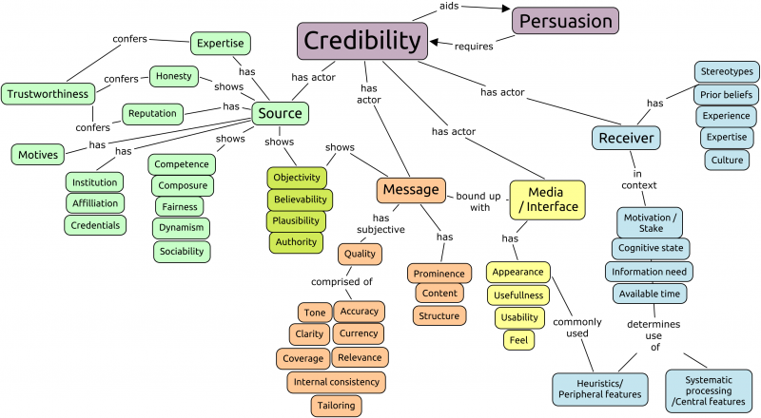
Persuasion Map
Matthews, P. (2013)

Slide 3
Basic Persuasion Map
Evidence/Explain
Ask/ Call to Action
Support 1
Evidence/Explain
Evidence/Explain
Evidence/Explain
Argument
Support 2
Evidence/Explain
Evidence/Explain
Evidence/Explain
Evidence/Explain
Support 3
Evidence/Explain
Evidence/Explain

Slide 4
Components of a Persuasive Message
There are several interrelated components to persuasive messages
Gain attention (argument)
Raise a need (argument)
Deliver a solution (argument)
Provide a rationale (support)
Validate the views, preferences, and concerns of others (support)
Give counterpoints (optional) (support)
Call to action (conclusion/call to action)
The key is knowing how to communicate each of these components to the specific audience
Analyzing your audience
Gathering the right information
Developing a message

Slide 5

Introduction to Persuasion Tactics
Two primary ways people are persuaded
Rational and logic-based tactics (central route)
Direct and information based
Psychological and emotion-based power (peripheral route)
Auto-response based
These often interact

Slide 6
Rational and Logic-Based Tactics
Agenda
Issues/topics are often initially addressed one at a time
One party usually introduces each new issue to be discussed
If you can gain control of the order in which issues are discussed, you can introduce them in an order that benefits you
Try to prevent the other party from taking complete control
Offer to take turns introducing issues
Use contrast
Introduce several unattractive options prior to a final (relatively) attractive option that benefits you
The other party may believe the (relatively) attractive deal is the best they can do after seeing all of the previous options

Slide 7
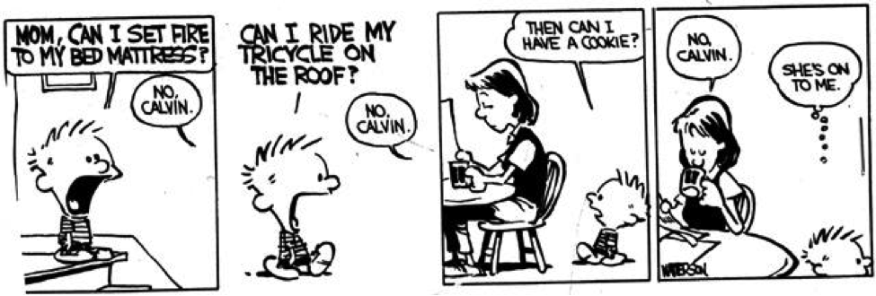
Psychological and Emotion-Based Tactic
Consistency (foot in the door)
People like to maintain consistency in their actions and beliefs
By getting the other party to like you and agree to a small request, you can create a psychological commitment
Small and easy agreements can lead to a larger agreement due to the desire to remain consistent

Slide 8

Six Principles of Persuasion

